Slide 1
Prediction model for stocks transactions
Zaikos Athanasios
Data Analyst

Slide 2
The dataset
200+ Financial Indicators of US stocks (2014-2018)
Companies ( Walmart, Apple, Amazon)
Indicators (Revenue,Profit Margin,Total Debt)
PRICE VAR [%]
Classes:
1 = BUY WORTHY
0 = NOT BUY WORTHY

Slide 3
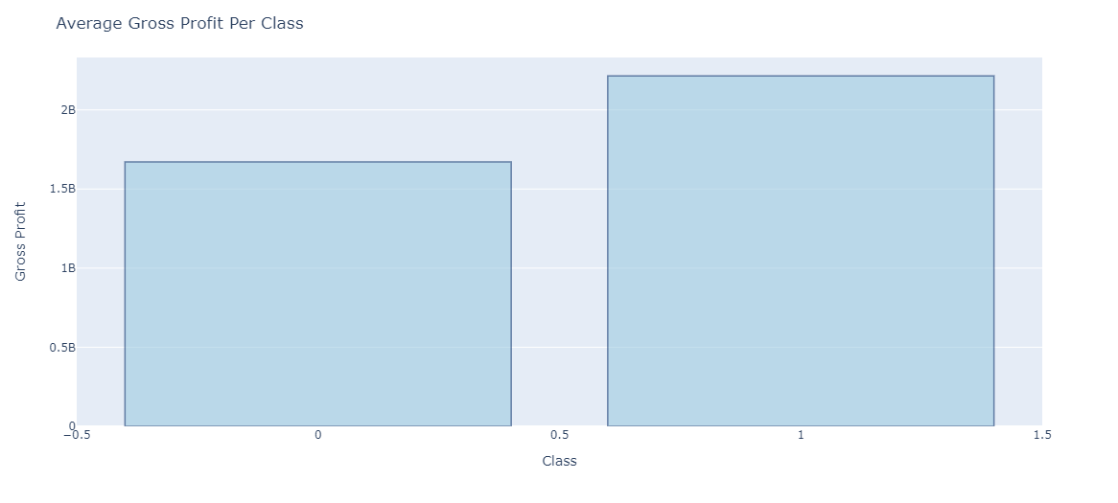
About the project
Do you know what helps you make your point clear?
Lists like this one:
They’re simple
You can organize your ideas clearly
You will never forget to buy milk!
And the most important thing: the audience will not miss any point of your presentation

Slide 4
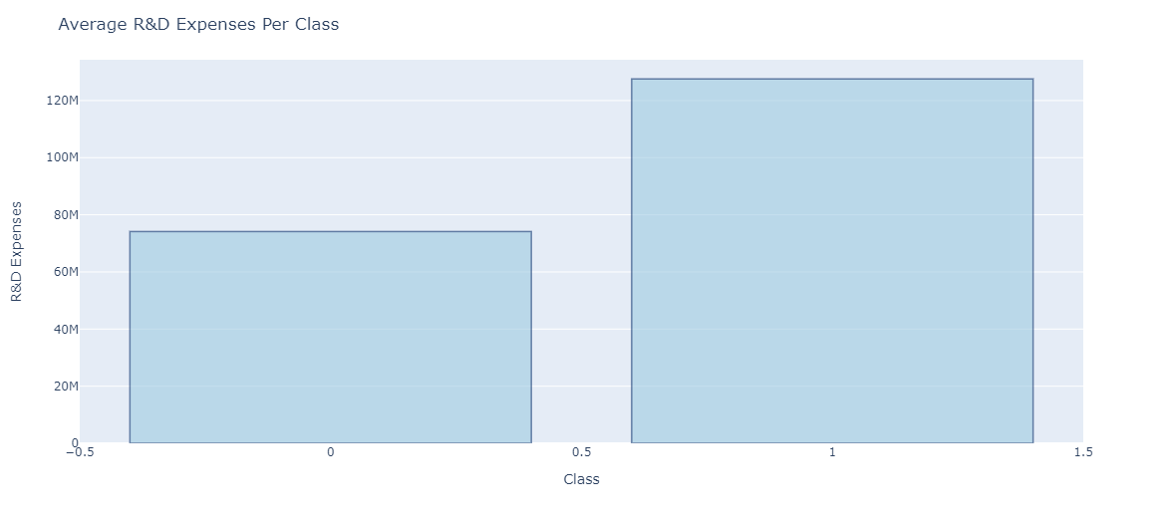
1
Meeting objectives
You can enter a subtitle her if you need it

Slide 5
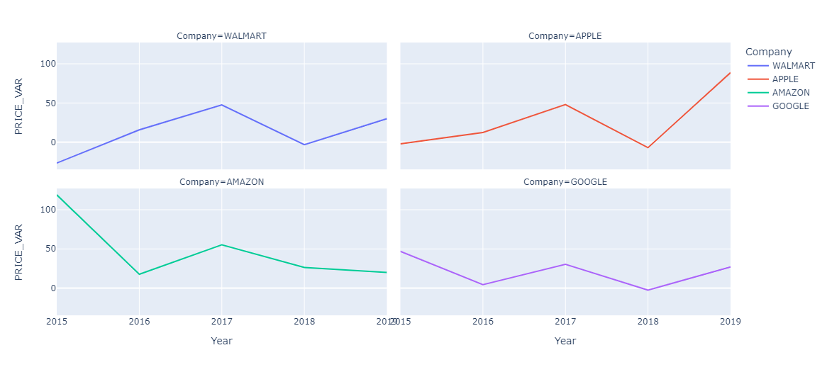
plotd
1
2
Objectives
Timeline
3
4
Schedule
Report
Describe the topic of the section here
Describe the topic of the section here
Describe the topic of the section here
Describe the topic of the section here

Slide 6
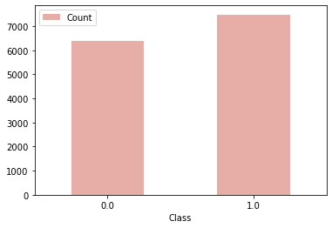
Data Processing
Get dummies for categorical values
Rename columns
Use an Imputer for NaN values
KNN Imputer(n=20)
Check for Imbalance in the Dataset

Slide 7
Continue Processing
Drop high correlated Indicators
Scale with StandardScaler()
Split
X_train,y_train
(2014,2015,2016,2017)
X_test,y_test
(2018)

Slide 8
Testing Classifiers
Classifiers | Accuracy | Precision | Recall
LogisticRegression(solver= 'liblinear') | 0.678506 | 0.770351 | 0.764281
DecisionTreeClassifier() | 0.611566 | 0.715296 | 0.730794
RandomForestClassifier() | 0.698998 | 0.761371 | 0.824360
GaussianNB() | 0.683060 | 0.707893 | 0.924491
KNeighborsClassifier() | 0.673042 | 0.746479 | 0.800394
Winner:
RandomForestClassifier()

Slide 9
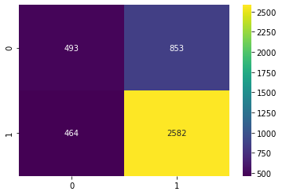
Grid Search and Prediction
Best Parameters
max_depth=4 , n_estimators=200
Final Prediction

Slide 11
Thanks!
Do you have any questions?

